Slide 1
LINKED LIST
PRESENTED BY : Swetali Mohanty

Slide 2

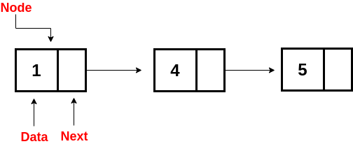
What are Linked Lists
A linked is a linear collection of data elements , called nodes . And each node consists of two fields: one field has data, and in the second field, the node has an address that keeps a reference to the next node.

Slide 3
Types Of Linked List
There are three common types of Linked List.
2.Doubly Linked List
3.Circular Linked List
1.Singly Linked List

Slide 4
Singly Linked List
Singly linked list can be defined as the collection of ordered set of elements.
A node in the singly linked list consist of two parts: data part and link part.
Data part of the node stores actual information that is to be represented by the node while the link part of the node stores the address of its immediate successor.
In the above figure, the arrow represents the links. The data part of every node contains the marks obtained by the student in the different subject. The last node in the list is identified by the null pointer which is present in the address part of the last node.

Slide 5
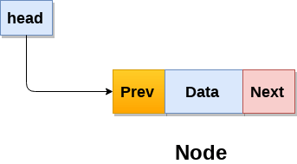
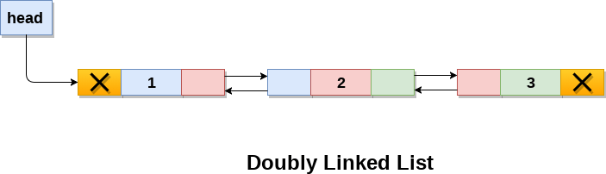
Doubly Linked List
Doubly linked list is a complex type of linked list in which a node contains a pointer to the previous as well as the next node in the sequence.
Therefore, in a doubly linked list, a node consists of three parts: node data, pointer to the next node in sequence (next pointer) , pointer to the previous node (previous pointer).
A doubly linked list containing three nodes having numbers from 1 to 3 in their data part, is shown in the following figure.

Slide 6

Circular Linked List
The circular linked list is a linked list where all nodes are connected to form a circle. In a circular linked list, the first node and the last node are connected to each other which forms a circle. There is no NULL at the end.
There are generally two types of circular linked lists:
Circular singly linked list
Circular Doubly linked list

Slide 7
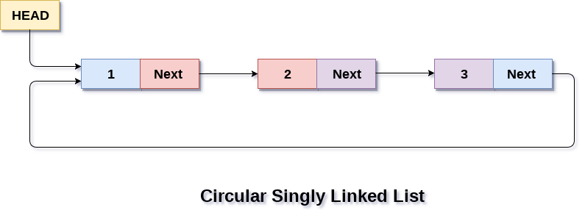
Circular singly linked list :
In a circular Singly linked list, the last node of the list contains a pointer to the first node of the list.
The circular singly linked list has no beginning or end. No null value is present in the next part of any of the nodes.

Slide 8
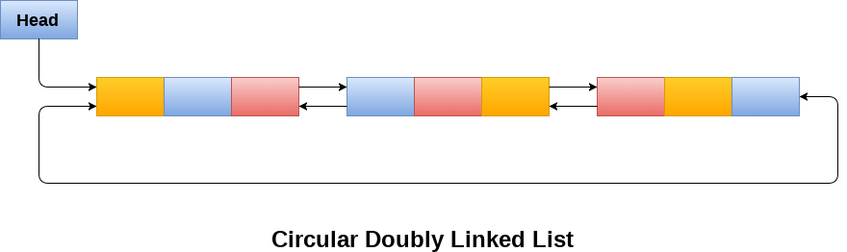
Circular Doubly linked list :
Circular doubly linked list is a more complexed type of data structure in which a node contain pointers to its previous node as well as the next node.
Circular doubly linked list doesn't contain NULL in any of the node. The last node of the list contains the address of the first node of the list. The first node of the list also contain address of the last node in its previous pointer.

Slide 9
Basic Operations on Linked List
Traversal: To traverse all the nodes one after another.
Insertion: To add a node at the given position.
Deletion: To delete a node.
Searching: To search an elements by value.
Updating: To update a node.
Sorting: To arrange nodes in a linked list in a specific order.
Merging: To merge two linked lists into one.

Slide 10
Linked List Traversal
The idea here is to step through the list from beginning to end.
For example, we may want to print the list or search for a specific node in the list.
The algorithm for traversing a list
Start with the head of the list. Access the content of the head node if it is not null.
Then go to the next node(if exists) and access the node information
Continue until no more nodes (that is, we have reached the null node)

Slide 11
Linked List node Insertion
There can be three cases that will occur when we are inserting a node in a linked list.
Insertion at the beginning
Insertion at the end. (Append)
Insertion after a given node

Slide 12
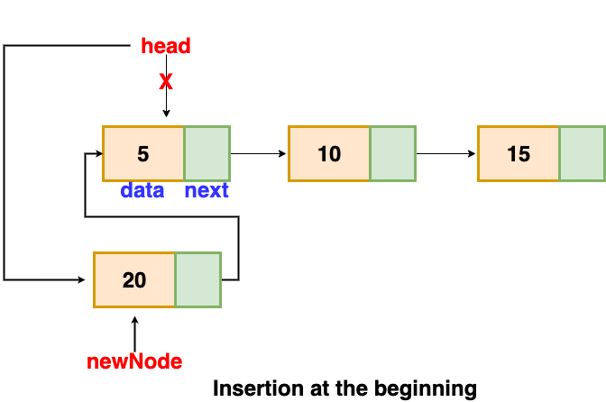
Insertion at the beginning
Since there is no need to find the end of the list. If the list is empty, we make the new node as the head of the list. Otherwise, we must connect the new node to the current head of the list and make the new node, the head of the list.

Slide 13
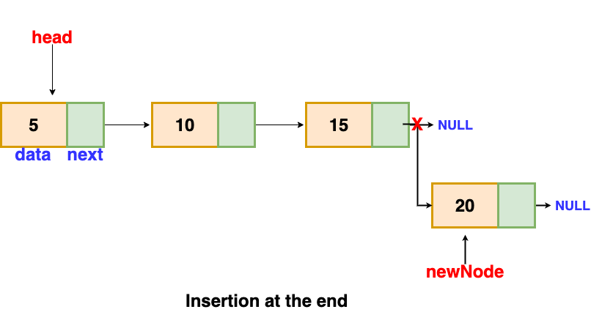
Insertion at end
We will traverse the list until we find the last node. Then we insert the new node to the end of the list.

Slide 14
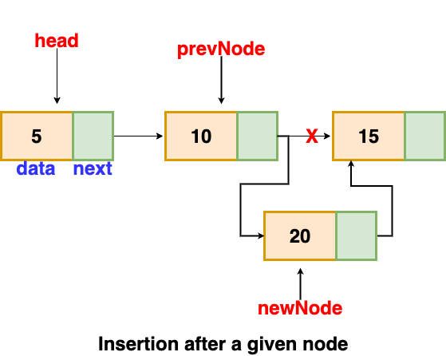
Insertion after a given node
We are given the reference to a node, and the new node is inserted after the given node.

Slide 15
Linked List node Deletion
To delete a node from a linked list, we need to do these steps
Find the previous node of the node to be deleted.
Change the next pointer of the previous node
Free the memory of the deleted node.
In the deletion, there is a special case in which the first node is deleted. In this, we need to update the head of the linked list.

Slide 16
Applications of linked list in the real world:
Image viewer – Previous and next images are linked and can be accessed by the next and previous buttons.
Previous and next page in a web browser – We can access the previous and next URL searched in a web browser by pressing the back and next buttons since they are linked as a linked list.
Music Player – Songs in the music player are linked to the previous and next songs. So we can play songs either from starting or ending of the list.

Slide 17
THANK YOU !!

